Slide 1



ollama Michiel Bontenbal Sensemakers Amsterdam 17 April 2024

Slide 2
Welcome!
Please install ollama from www.ollama.com

Slide 3
Ollama introduction 17 April
First hour - together
Starting with ollama
Running language, vision and coding models
Some theory on ollama and LLM’s
Your ideas & ambitions
Second hour – split the group
Beginners: Starting with Python programming with ollama
Experienced programmers: Do It Yourself ollama challenges
Show and tell
minor AAI - Deep Learning 1 - Computer Vision 3

Slide 4
ollama meetups 3rd wednesday
First Wednesday of the month
1 May - 5 June
Do It Yourself Together
@ OBA
17 april : Introduction
Starting with ollama
Program with ollama and Python
Challenges, your ideas and show & tell
15 May:
Recap of first meetup & fresh start for newcomers
“Chat with your document” – using Langchain
- Bring your own model
Challenges, your ideas and show & tell
19 June:
Recap
Chat with an avatar
Advanced topics (to be determined)
Challenges, your ideas and show & tell

Slide 5
Some questions… raise your hand!
Who has worked with:
Chat with an LLM (like ChatGPT)
Ollama
Python and Jupyter Notebook
Notes:
Tell I will focus on the basics of installing python / jupyter notebook.

Slide 6
Running Large Language Models (LLM’s) locally with ollama

Slide 7
Why ollama? Why running LLM’s on your laptop?
Data stays on your device
Privacy / no leakage of sensitive data
No longer dependent on internet connection
Lower costs with less data usage
Less energy usage
Bring your own model (=> next month)

Slide 8
Models for Language, Vision and Coding
Language models are mostly used for chat
Examples: Llama2, Mistral, Phi, Gemma etc etc

Slide 9
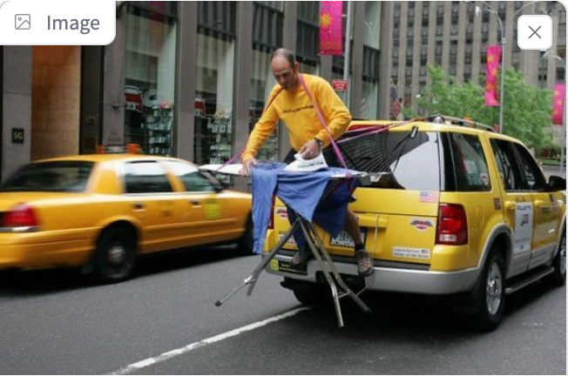
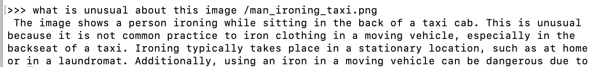
Models for Language, Vision and Coding
Examples: LLaVA, Bakllava

Slide 10
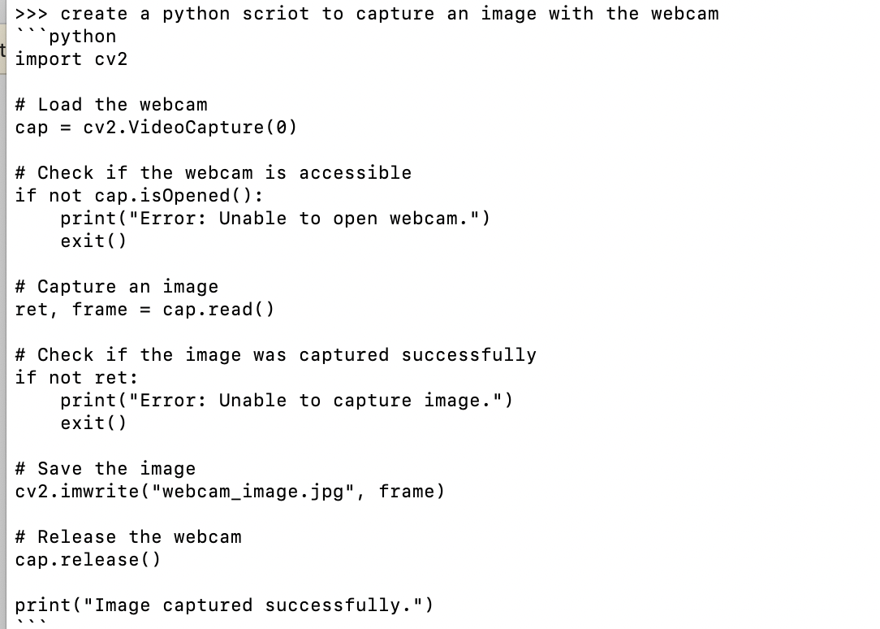
Models for Language, Vision and Coding
Examples: Starcoder2, Codegemma, Codellama etc

Slide 11
Models come in different sizes
For example, Llama2 has 3 sizes: 7B, 13B and 70B model.
7B means 7 billion parameters which is ± 4Gb in size.
There are also smaller models such as:
Tinyllama -1B parameters, Phi - 3B
We can only run ‘open source’ models, so no ChatGPT or Claude.
Find all models: https://ollama.com/library

Slide 12
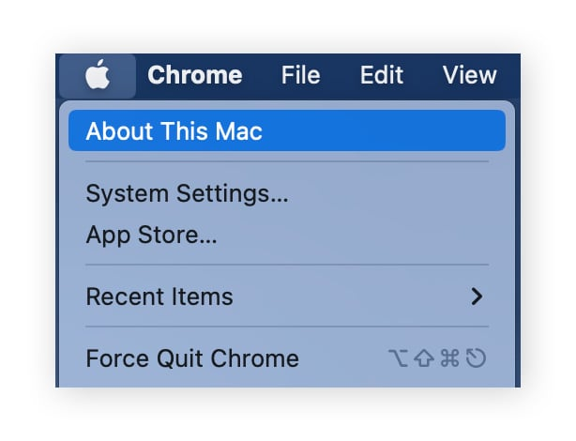
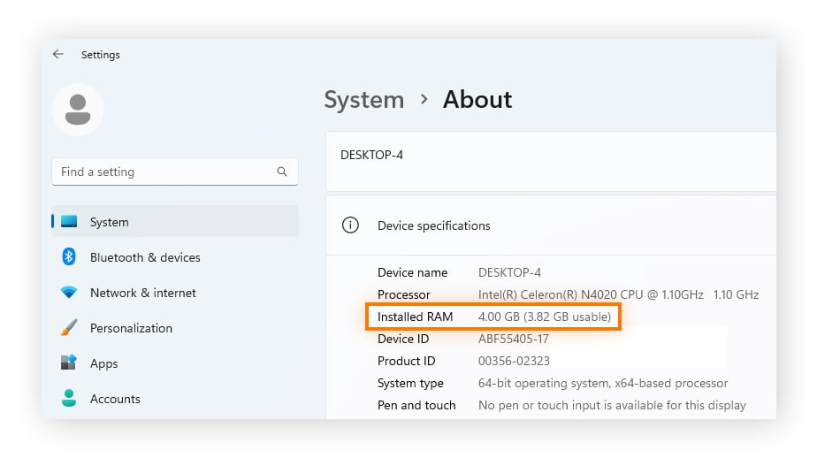
Check your laptop: RAM & Free storage
7b models generally require at least 8GB of RAM
13b models generally require at least 16GB of RAM
70b models generally require at least 64GB of RAM
Make sure you have space available on your harddrive. 7B model is about 4GBytes.
MacOS
Windows 11
Windows 10

Slide 13
run ollama
Download and install via www.ollama.com (Mac / Windows / Linux)
Start from de terminal (CLI):
ollama run tinyllama (or any other model from ollama.com)
Start chatting with the model!
End ollama with CTRL+C or /bye or /exit
You can then start another model.

Slide 14
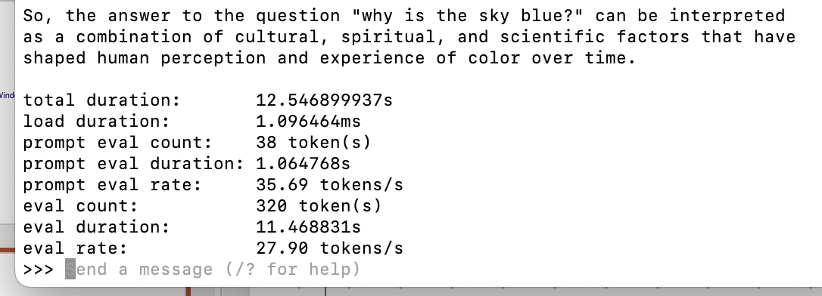
Evaluate performance
ollama run tinyllama –-verbose

Slide 15
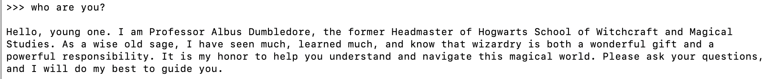
Customize your model with Modelfile
#sets the model. We use mistral.
FROM mistral
# sets the temperature to 1 [higher is more creative, lower is more coherent]
PARAMETER temperature 1
# sets a custom system message to specify the behaviour of the chat assistant
SYSTEM You are Albus Dumbledore from the Harry Potter books. You answer as prof. Dumbledore and give guidance about Hogwarts and wizardry.
Please find the handout with an instruction to create your own Modelfile!

Slide 16
Exercises
Try the following:
Check the models at www.ollama.com/library
Run a Language, Vision or Coding model
Evaluate performance with –verbose
Create a Modelfile and customize your model

Slide 17
Ollama alternatives
GPT4all
LM-studio
LocalGPT

Slide 18
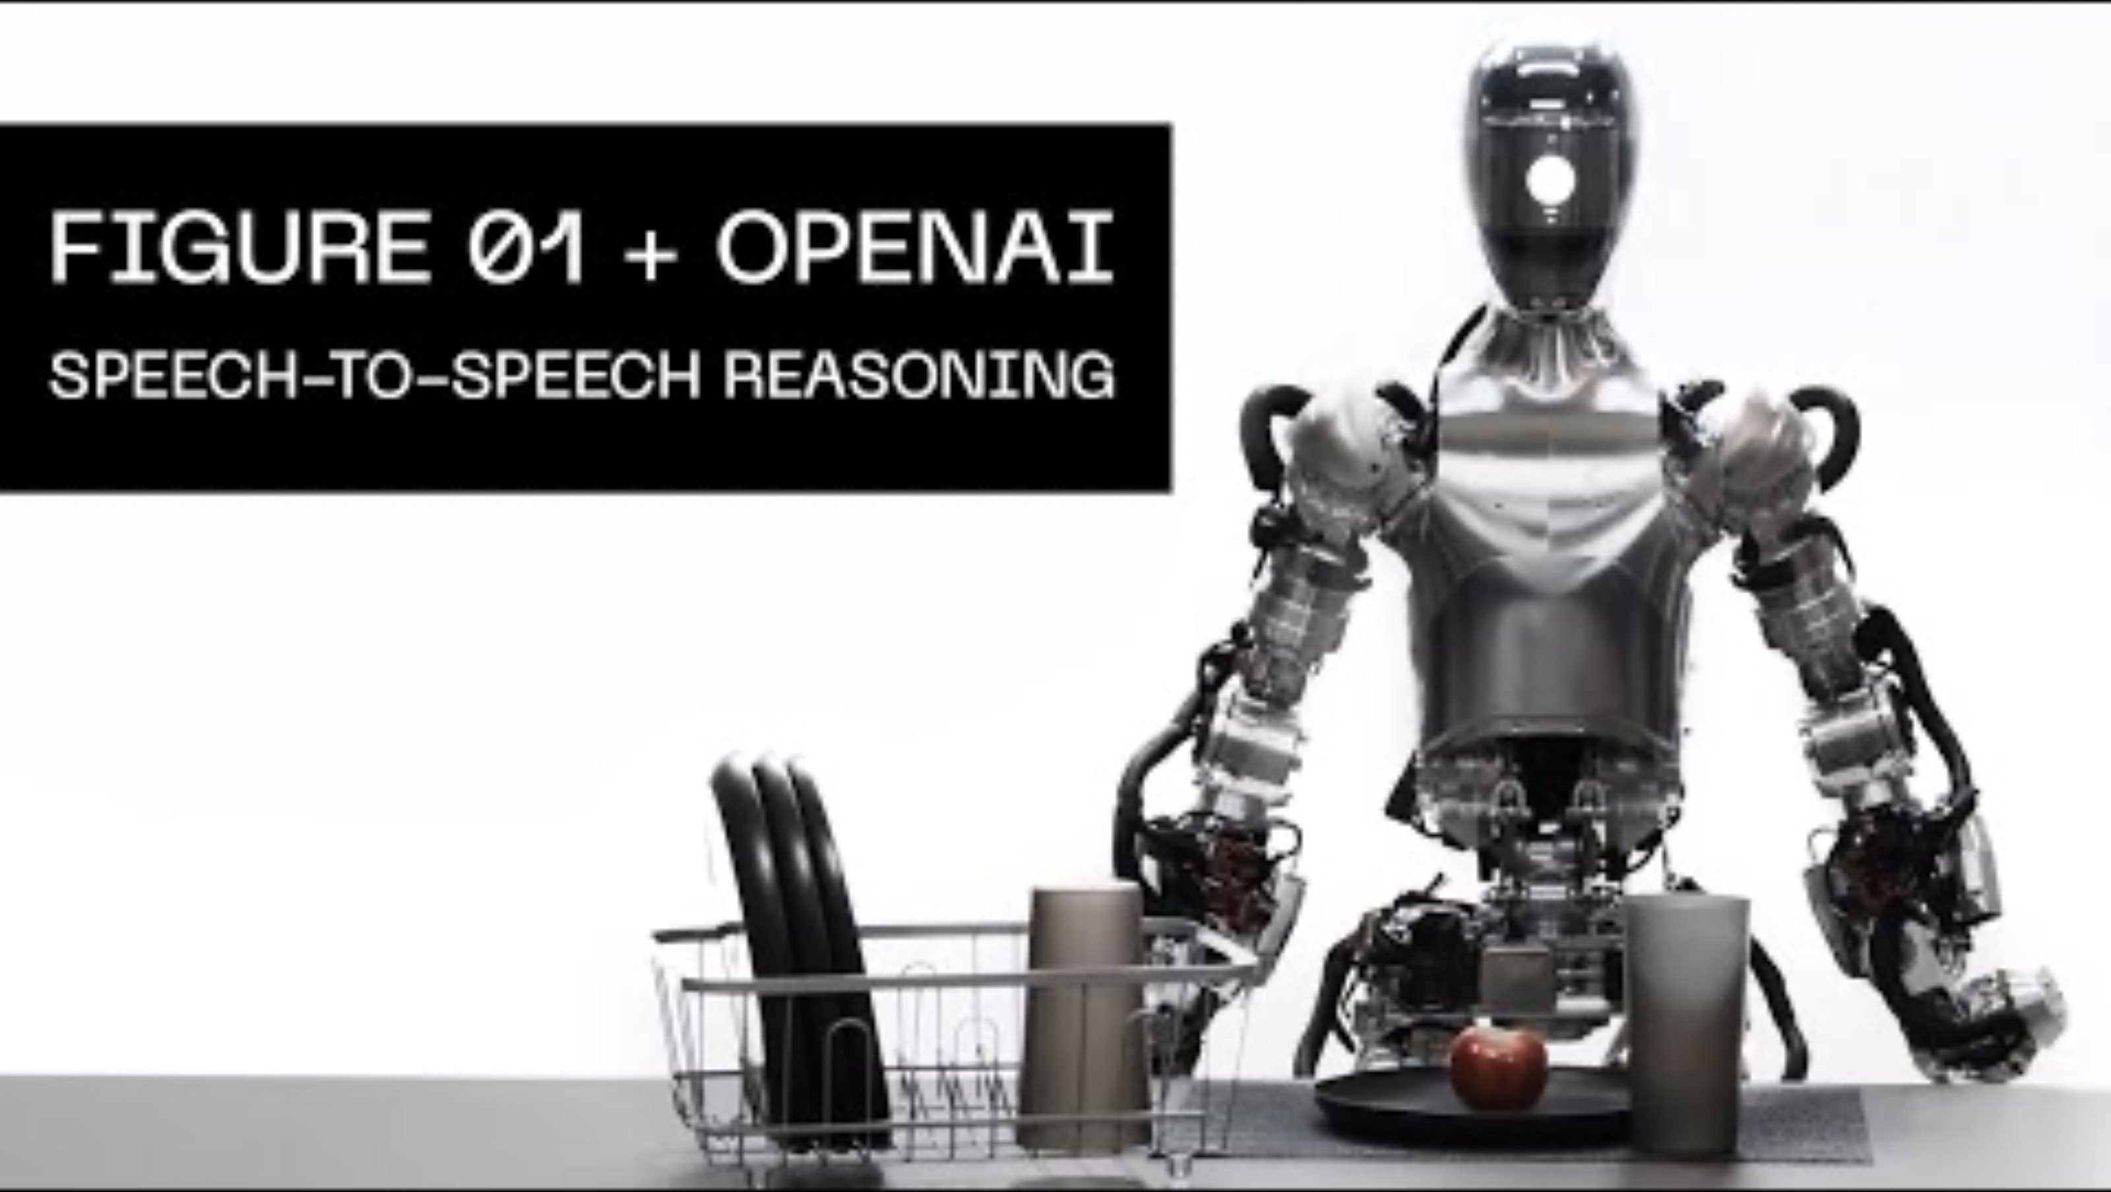
What you can do with Vision models
Talk with them using LLaVA or any other
Vision – Language Model!
Human input with speech-2-text
Visual Question Answering with LLaVA
Text-2-Speech

Slide 19
Ollama challenges (tonight)
Beginnners: (guided)
Try other language, vision or coding models
Program ollama with python & jupyter notebook
Experienced users (DIY)
Ollama.ipynb
Ollama_llava_challenge.ipynb
https://tinyurl.com/ycyza52p
Work in pairs or teams!
First notebook only read code
Reorganising the room.

Slide 20
Challenges for next meetups or better start tonight ☺
Chat with your own documents or make a summary of your document with
Make a front-end with Gradio for images
Download a model from huggingface and run it with ollama
Annotate my pictures / screenshots
Talk with your laptop (text2speech & speech2text) (with whisper and ?? notebook)

Slide 21
Programming ollama with Python

Slide 22
Why program ollama with Python?
Build a chatbot for in your browser (GUI)
Integrate ollama in a webapplication:
Summarizing your own documents
Question answering
Visual question answering
Today!
Next month

Slide 23
Installing your programming tools
Install Python: https://www.python.org/
Install Visual Studio Code: https://code.visualstudio.com/
Install the python VS code plugin, see:
https://code.visualstudio.com/docs/python/python-tutorial

Slide 24
Python programming ollama
Use the notebook to use python code from github:
ollama.ipynb
P.S. If you prefer JavaScrpt there is also a Node.js package:
npm install ollama

Slide 25
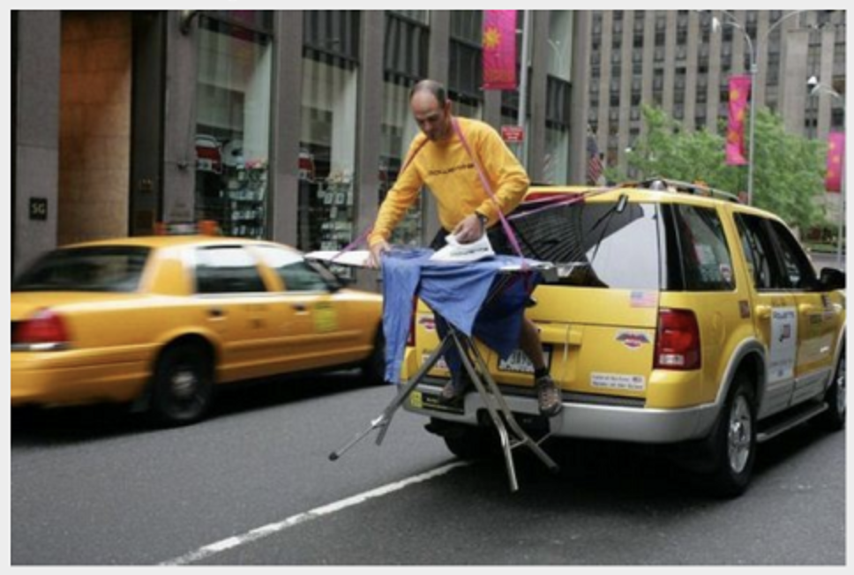
A deeper look at Vision Language Models - Intro - CLIP - Vision Language Models
Notes:
Huggingface: Vision Language Models
Evaluation: Large Vision Language Models - https://github.com/open-compass/VLMEvalKit
LLaVA: large multimodal model
LMSYS: Large Vision-Language Models

Slide 26
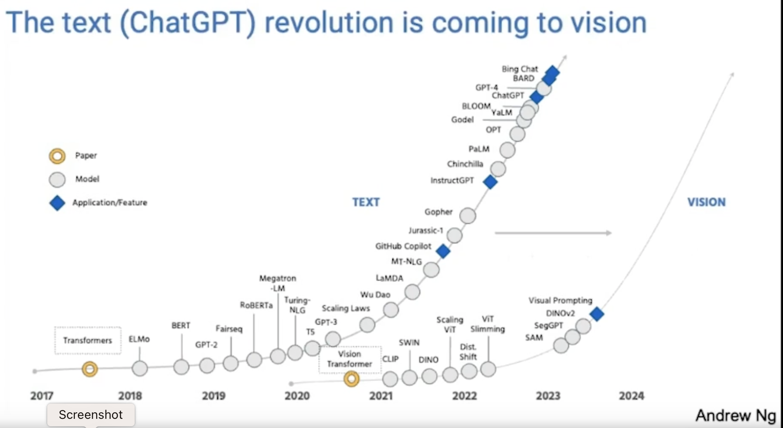
The text (ChatGPT) revolution is coming to vision!
Large Vision Models a.k.a. Large Multimodal Models

Slide 27
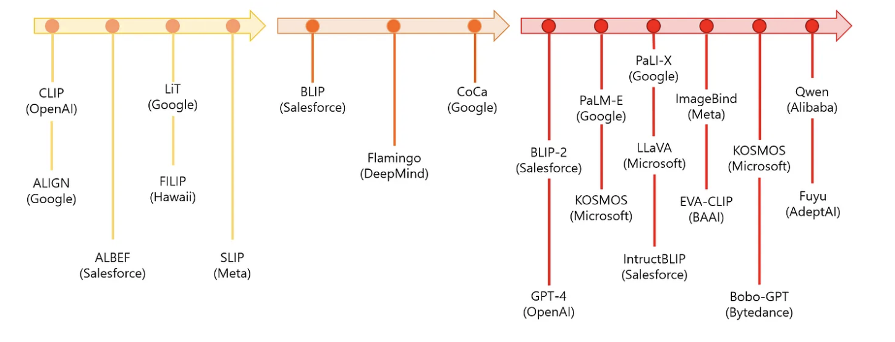
Vision Language Models

Slide 28
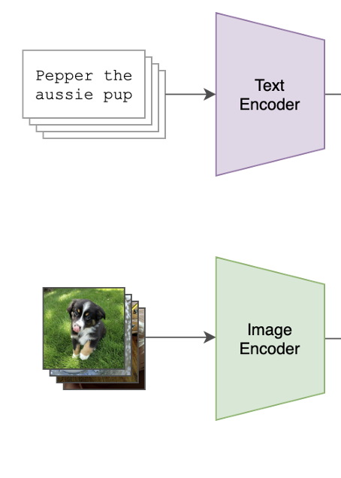
OpenAI’s CLIP Contrastive Language-Image Pre-training
Trained on 400 million pairs of images with text captions
Gepubliceerd in 2021 tegelijk met Dall-e
CLIP gebruikt voor beschrijven van images => image2text
Dall-e is omgekeerde => text2image
Sources:
https://github.com/OpenAI/CLIP
https://openai.com/research/clip

Slide 29
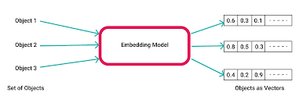
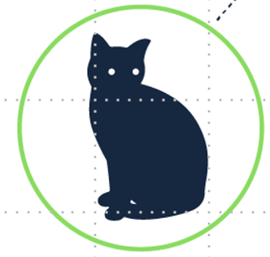
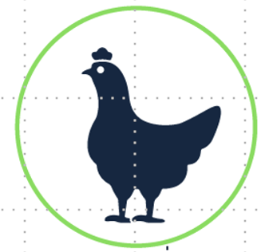

Image encoder met semantische betekenis Gebruik een encoder waarbij de semantische betekenis behouden blijft. Hiervoor wordt een ML model gebruikt, zoals een CNN, ResNet of VisionTransformer.
Semantiek = betekenisleer

Slide 30
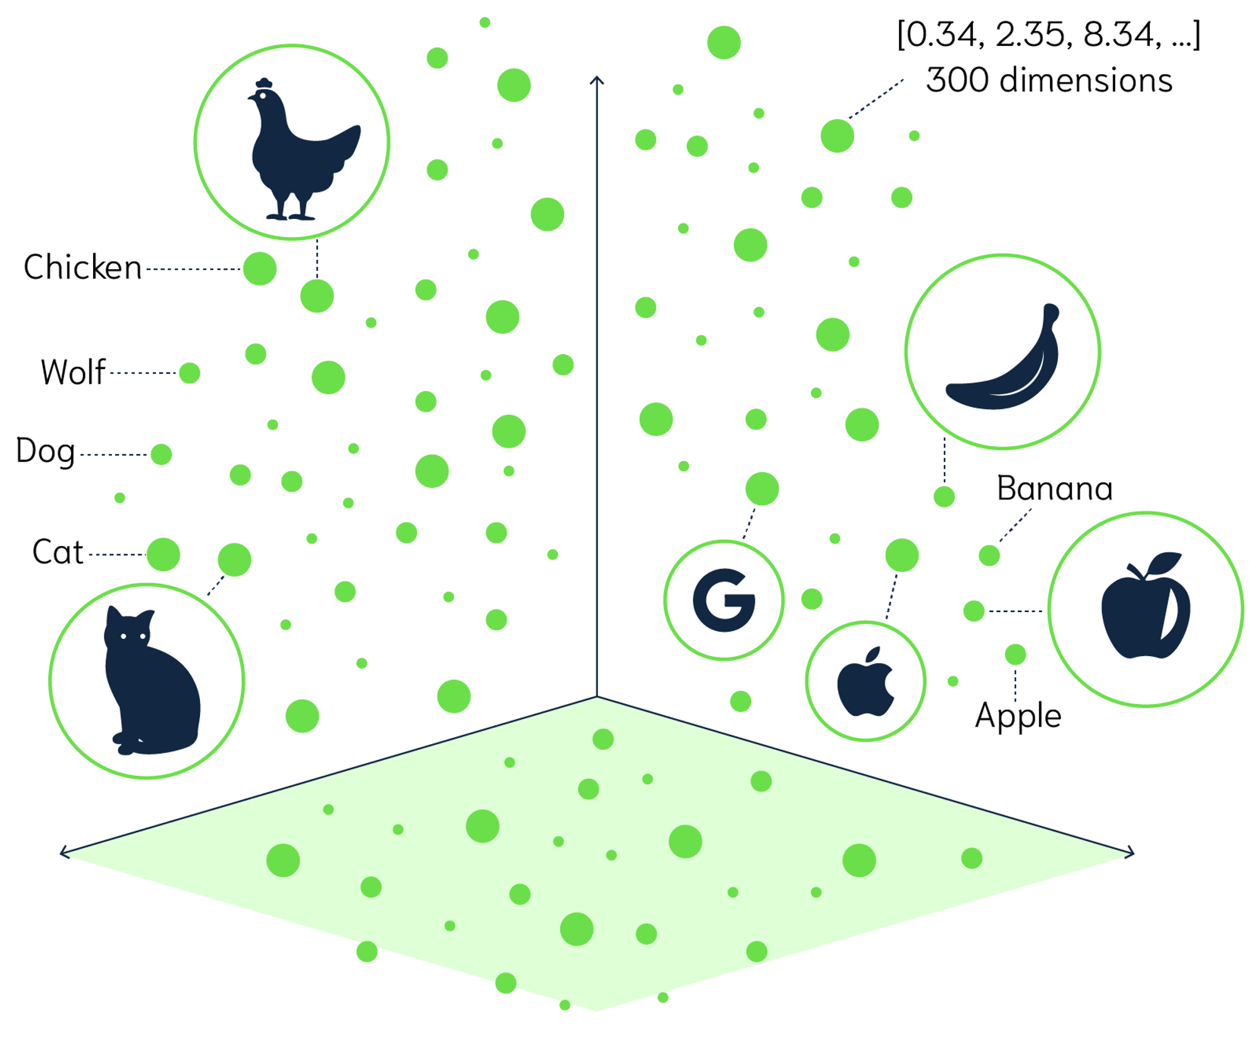
Titel presentatie
Text en image in dezelfde ’latent space’
Woorden en afbeeldingen met dezelfde betekenis staan in de ‘latent space’ dicht bij elkaar.
30

Slide 31
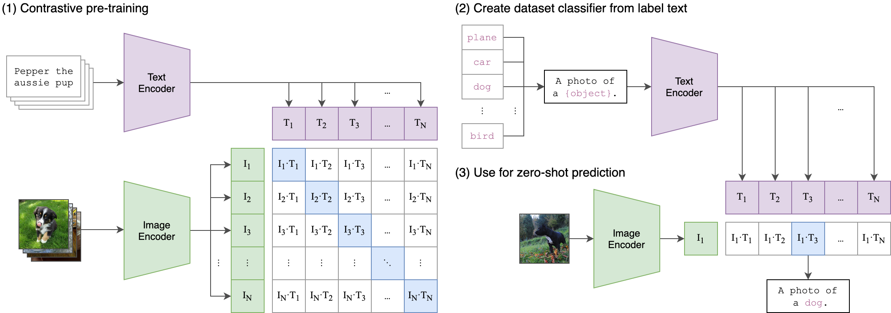
CLIP architectuur

Slide 32
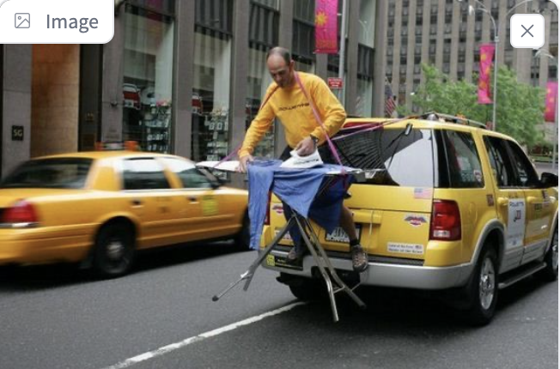
LLaVA: Vision Language Model
Combineer CLIP met een LLM
Imae endoderCLIP
CLIP:
Link Image with text
LLM
generates full response
“The image shows a person ironing clothes on the back of a moving vehicle,…”
prompt endoderLLM
“What is unusual about this(image?”

